Slide 1

Funnels with Warby Parker
Learn SQL from Scratch
Michael Tribe
6/22/18

Slide 2
Usage Funnels with Warby Parker

Slide 3
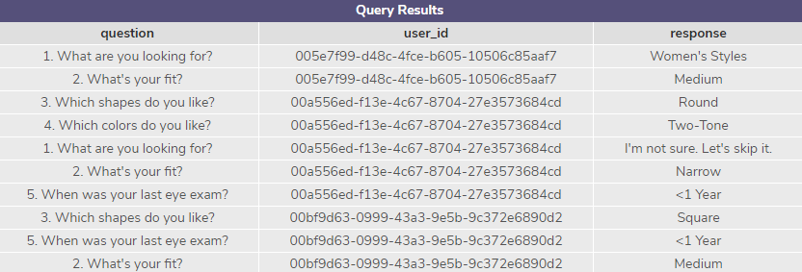
1. The users' responses are stored in a table called survey.
Select all columns from the first 10 rows. What columns does the table have?
The table called survey contains the following three columns
question (TEXT)
user_id (TEXT)
response (TEXT)
SELECT *
FROM survey
LIMIT 10;

Slide 4
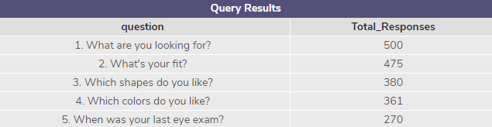
2. Create a quiz funnel using the GROUP BY command.
What is the number of responses for each question?
475 users move from Question 1 to Question 2. The table below, on the right, highlights that 500 users responded to question 1, 475 to question 2, 380 to question 3, 361 to question 4, and 270 to question 5.
SELECT question, COUNT(*) AS ‘Total_Responses’
FROM survey
GROUP BY 1;

Slide 5
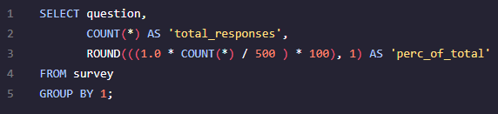
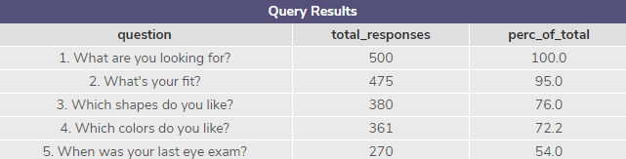
3. Calculate the percentage of users who answer each question
Which question(s) of the quiz have a lower completion rates?
Rather than using Excel or Google sheets I added column to my sql query to highlight the percentage of total (perc_of_total). There were 500 users that initiated a response to the questionnaire. Question 5 had the lowest completion rate of 54% and question 4 had the second lowest completion rate of 72%.
What do you think is the reason?
I think the reason that we see the largest drop in completion between questions 4 and 5 is the relevance of the question. Asking a customer when their last eye exam was doesn’t really fit with the other questions being asked. Also the longer a survey is the more drop off you will see which appears to be typical for any online survey.
SELECT question,
COUNT(*) AS 'total_responses',
ROUND(((1.0 * COUNT(*) / 500 ) * 100), 1) AS 'perc_of_total'
FROM survey
GROUP BY 1;

Slide 6
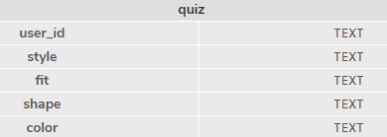
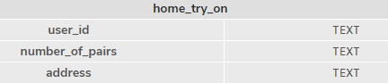
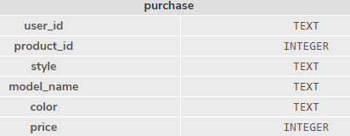
4. Warby Parker's purchase funnel
What are the column names?
The column names for the quiz, home_try_on, and purchase tables are listed below
quiz table column names | home_try_on table column names | purchase table column names
user_id | user_id | user_id
style | number_of_pairs | product_id
fit | address | style
shape |  | model_name
color |  | color
 |  | price

Slide 7
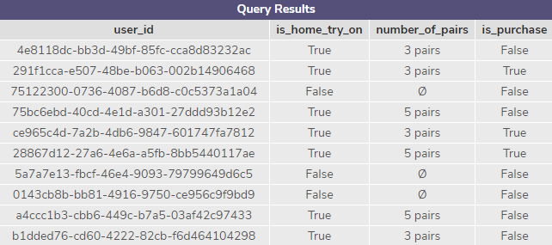
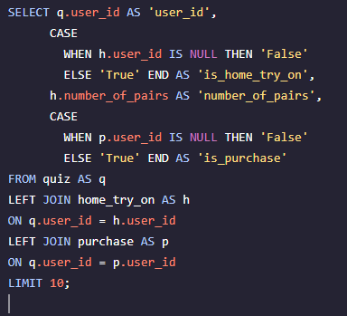
5. We'd like to create a new table
In this newly created table I did a LEFT JOIN to determine if those users that engaged in the quiz had any entries in the home_try_on or purchase table.
In the table below are the first ten rows that were returned in the query.
SELECT q.user_id AS 'user_id',
CASE
WHEN h.user_id IS NULL THEN 'False'
ELSE 'True' END AS 'is_home_try_on',
h.number_of_pairs AS 'number_of_pairs',
CASE
WHEN p.user_id IS NULL THEN 'False'
ELSE 'True' END AS 'is_purchase'
FROM quiz AS q
LEFT JOIN home_try_on AS h
ON q.user_id = h.user_id
LEFT JOIN purchase AS p
ON q.user_id = p.user_id
LIMIT 10;

Slide 8
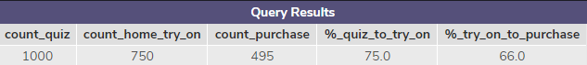
6. Once we have the data in this format, we can analyze it in several ways
For this section I started with the script created in section 5, on the previous slide. I passed the previous script in a WITH statement titled ‘funnels’. I then created another WITH statement titled ‘conversion’ FROM ‘funnels’ which contains the following columns to aggregate the required data to then compare conversion.
‘count_quiz’ - COUNT (user_id) which is the total number of users in the quiz table. The quiz table contains the results of the survey for each user.
‘count_home_try_on’ – CASE statement that uses SUM to consider all ‘True’ values from the funnels temporary table, ‘is_home_try_on’ column, as the number 1. The addition of all of the 1 provides the ‘count_home_try_on’ total. I could have also used a CASE statement with COUNT to count all of the ‘True’ values
‘’count_purchase’ – this column does the same thing as the previous column however it is using the ‘is_purchase’ column from the funnels temporary table
Now with the conversion temporary deriving its results from the funnels temporary table I created a select statement FROM the conversion table to compare the conversion from ‘quiz > home_try_on’ and ‘home_try_on > purchase’. The SELECT statement contains the following columns.
‘count_quiz’ - from the ‘conversion’ temporary table. 1000 users are contained in the quiz table
‘count_home_try_on’ - from the ‘conversion’ temporary table. 750 users engaged in ‘home_try_on’
‘count_purchase’ - from the ‘conversion’ temporary table. 495 users made a purchase.
‘%_quiz_to_try_on’ – ‘count_home_try_on’ divided by ‘count_quiz’ multiplied by 100, to view the percentage of total users in the quiz table that engaged in ‘home_try_on’. I also converted ‘count_home_try_on’ to a float by multiplying it by 1.0 so that the correct results would be provided. 75% of those users in the quiz table engaged in ‘home_try_on’
‘%_try_on_to_purchase – ‘count_purchase’ divided by ‘count_home_try_on’ multiplied by 100, to view the percentage of total users in the engaged in ‘home_try_on that then made a purchase. I also converted ‘count_purchase’ to a float by multiplying it by 1.0 so that the correct results would be provided. 66% of those users that engaged in ‘home_try_on’ made a purchase.
Actionable Insights:
Follow up email to those users that didn’t more beyond the quiz down the funnel to receive feedback to the barriers of continuing down the funnel
Possible a/b test with the quiz to see if the number/types of question are possible barriers.
WITH funnels AS (SELECT q.user_id AS 'user_id', CASE
WHEN h.user_id IS NULL THEN 'False'
ELSE 'True' END AS 'is_home_try_on',
h.number_of_pairs AS 'number_of_pairs',
CASE WHEN p.user_id IS NULL THEN 'False'
ELSE 'True' END AS 'is_purchase'
FROM quiz AS q
LEFT JOIN home_try_on AS h
ON q.user_id = h.user_id
LEFT JOIN purchase AS p
ON q.user_id = p.user_id),
conversion AS (SELECT COUNT(user_id) AS 'count_quiz', SUM(CASE WHEN is_home_try_on = 'True' THEN 1 ELSE NULL END) AS ‘count_home_try_on', SUM(CASE WHEN is_purchase = 'True' THEN 1 ELSE NULL END) AS 'count_purchase'
FROM funnels)
SELECT count_quiz,
count_home_try_on,
count_purchase,
(1.0 * count_home_try_on / count_quiz) * 100 AS ‘%_quiz_to_try_on’,
(1.0 * count_purchase / count_home_try_on) * 100 AS ‘%_try_on_to_purchase’
FROM conversion;

Slide 9
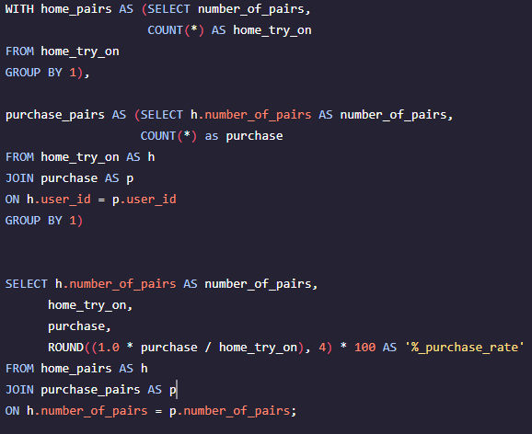
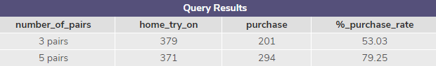
6. Calculate the difference in purchase rates between customers who had 3 number_of_pairs with ones who had 5.
I have added the sql script in the text box on the right. I also included a screen shot as the text didn’t paste correctly into the text box
As you can see in the sql script I have created two temporary table in the WITH clause. The two tables return the following data.
‘home_pairs’ temporary table returns the COUNT of ‘3 pairs’ and ‘5 pairs’ from the ‘home_try_on’ table.
‘purchase_pairs temporary table returns the COUNT of ‘3 pairs’ and ‘5 pairs’ when the ‘purchase’ table is INNER JOINed to the ‘home_try_on’ table
The SELECT statement following the two temporary tables contained in the WITH clause returns the following.
‘number_of_pairs’ - from the ‘home_pairs’ temporary table. ‘3 pairs’ and ‘5 pairs’
‘home_try_on’ – from the ‘home_pairs’ temporary table. ‘3 pairs’ = 379 and ‘5 pairs’ = 371
‘ purchase’ – from the ‘purchase_pairs’ temporary table. ‘3 pairs’ = 201 and ‘5 pairs’ = 294
‘%_purchase_rate – the ‘purchase’ column is divided by the ‘home_try_on’ column. ‘3 pairs’ = 53.05% and ‘5 pairs’ = 79.25%
Based on these results we can see that 8 more users engaged in the 3 pairs home try on option than the 5 pair option. However the conversion rate to purchase for the 5 pairs option is about 26% higher than the 3 pair home try option.
Actionable Insights
Offer a 1 pair & 2 pairs home try on to influence a greater conversion rate to purchase for those 3 pairs users that did not make a purchase.
Conduct a follow up email for those users that did not purchase to determine what barriers/reason were behind not purchasing
WITH home_pairs AS (SELECT number_of_pairs,
COUNT(*) AS home_try_on
FROM home_try_on
GROUP BY 1),
purchase_pairs AS (SELECT h.number_of_pairs AS number_of_pairs,
COUNT(*) as purchase
FROM home_try_on AS h
JOIN purchase AS p
ON h.user_id = p.user_id
GROUP BY 1)
SELECT h.number_of_pairs AS number_of_pairs,
home_try_on,
purchase,
ROUND((1.0 * purchase / home_try_on), 4) * 100 AS '%_purchase_rate'
FROM home_pairs AS h
JOIN purchase_pairs AS p
ON h.number_of_pairs = p.number_of_pairs;

Slide 10
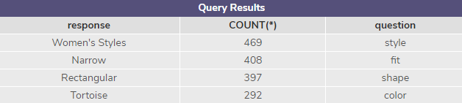
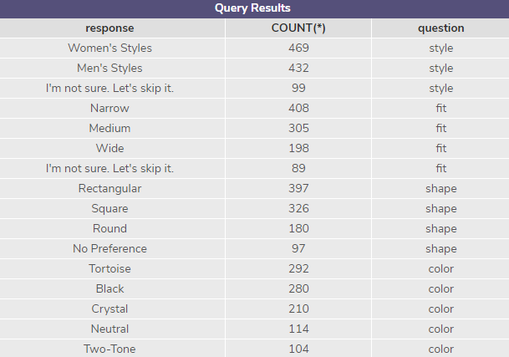
6. The most common results of the style quiz.
By creating a temporary table for each question I was able to view the count for each question response option. To include the top highest count for each question I would add LIMIT 1 to each temporary table in the WITH clause. The most common result for each question in the style quiz are as follows.
Based on the results we can see that the most popular response for each question were as follows. For the ‘style’ question ‘Womens Styles’ received 469 responses, ‘fit’ question ‘Narrow’ received 408 responses, ‘shape’ question ‘Rectangular’ received 397 responses, ‘color’ question ‘Tortoise’ received 292 responses.
Actionable Insights
Look at offering more product options for the most popular responses.
Possibly review different options that are not currently provided by Warby Parker to tap into the users that responded with ‘I’m not sure. Let’s skip it’.
Email those users for feedback that responded ‘I’m not sure, Let’s skip it’. There may be other reason other than just ‘I’m not sure, Let’s skip it’ from that group of users.
WITH style AS (SELECT style AS response,
COUNT(*),
'style' AS 'question'
FROM quiz
GROUP BY 1
ORDER BY 2 DESC),
fit AS (SELECT fit AS response,
COUNT(*),
'fit' AS 'question'
FROM quiz
GROUP BY 1
ORDER BY 2 DESC),
shape AS (SELECT shape AS response,
COUNT(*),
'shape' AS 'question'
FROM quiz
GROUP BY 1
ORDER BY 2 DESC),
color AS (SELECT color AS response,
COUNT(*),
'color' AS 'question'
FROM quiz
GROUP BY 1
ORDER BY 2 DESC)
SELECT *
FROM style
UNION ALL
SELECT *
FROM fit
UNION ALL
SELECT *
FROM shape
UNION ALL
SELECT *
FROM color;

Slide 11
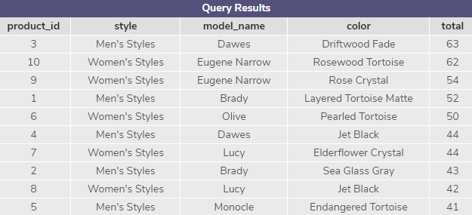
6. The most common types of purchase made
The most common types of purchases made can be view in the table below. The two most popular items purchase are.
With a total of 63 purchases is the Men’s Styles, Dawes model, Driftwood Fade color.
With a total of 62 purchases is the Women’s Styles, Eugene Narrow model, Rosewood Tortoise color
SELECT product_id, style, model_name, color, COUNT(*) AS 'total'
FROM purchase
GROUP BY 1
ORDER BY total DESC;

